Slide 1


Stock Market Trend Prediction
By
Philia Agam Ayuk
December 2025

Slide 2


Project Overview
MarketPulse Analystics engaged the service of a data scientist to deploy data-driven market analysis and predictive modeling to enhance trading performance and systematize decision-making.
Datasets specifications4 datasets
20 stocks across 5 sectors (Technology, Healthcare, Finance, Consumer, Energy).
3+ years of daily OHLCV data (approximately 750+ trading days per stock).
40+ technical indicators and derived features per stock per day
Use Machine Learning to classify stock market trend.

Slide 3
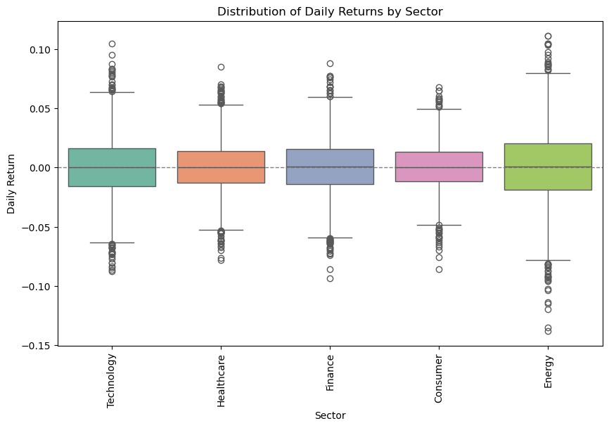

Dataset Summary
20 publicly traded stocks across five(5) sectors such as healthcare, finance, consumer, energy, technology.
Daily historical price data collected in (Open, High, Low, Close, Volume) format of 780 business days over 3 years.
Engineered technical indicators:
RSI, MACD, Bollinger Bands
Volatility and momentum measures
Market indices and company-level metadata used for context

Slide 4
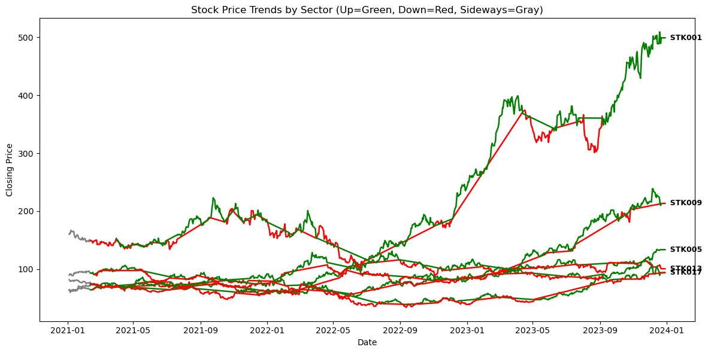
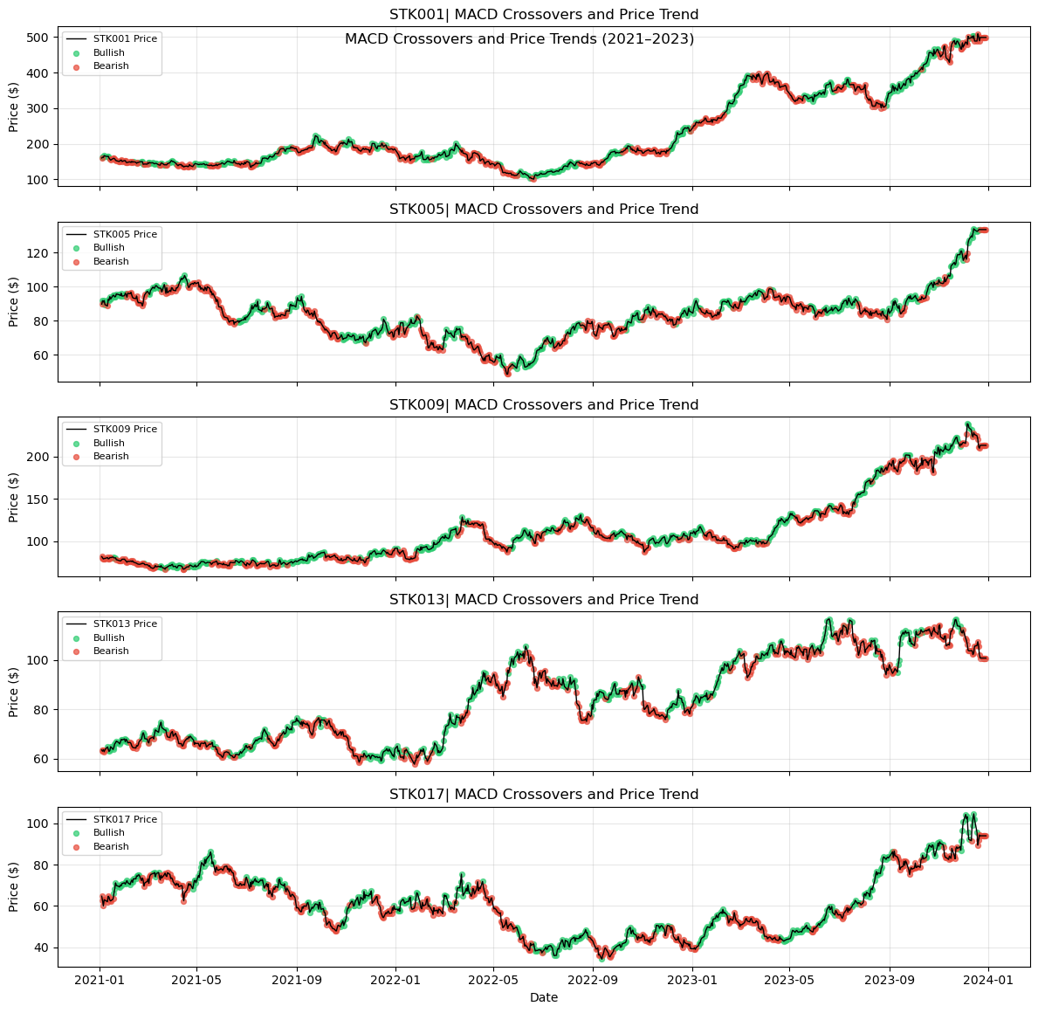


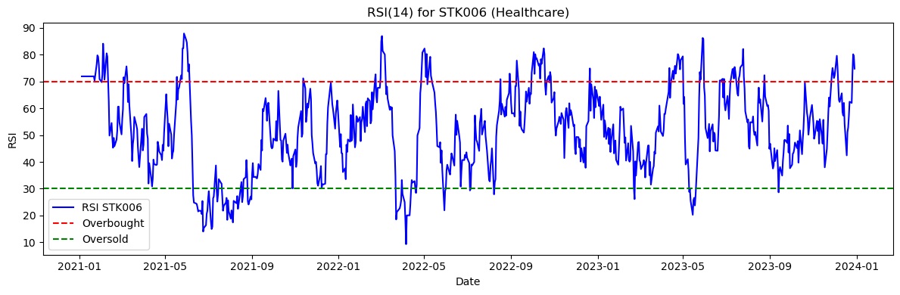
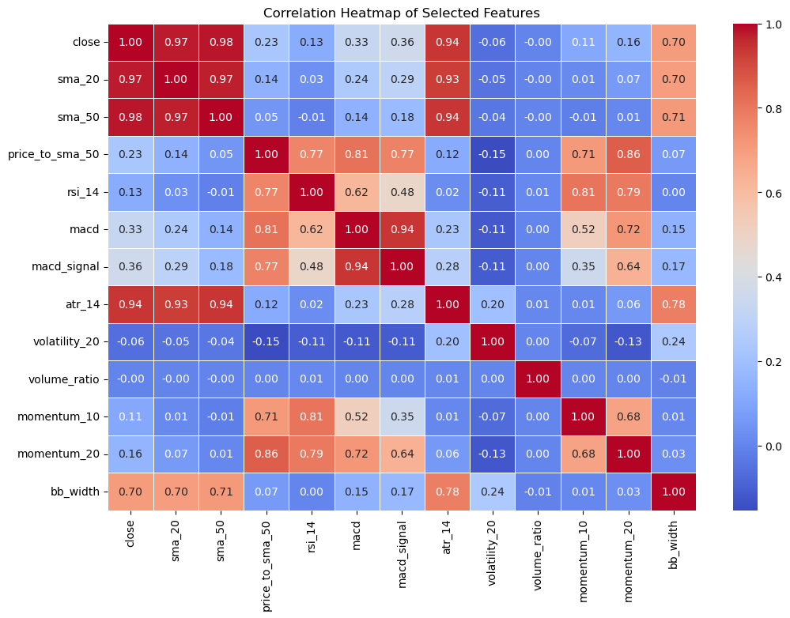
Key EDA Insights

Slide 5



Modeling Approach
Time-based train/test split
Improved Model
Baseline Model
Logistics Regression model: simple and commonly use, easy to interpret and understand.
Random Forest
Tuned Random Forest
Feature importance Random Forest
To avoid data leakages
A time-based split was used to reflect real-world trading, where future prices are predicted using only past information.
Why we chose these two?
Logistic Regression provides a simple baseline, while Random Forest is better suited for capturing the complex, non-linear patterns present in financial data.”

Slide 6
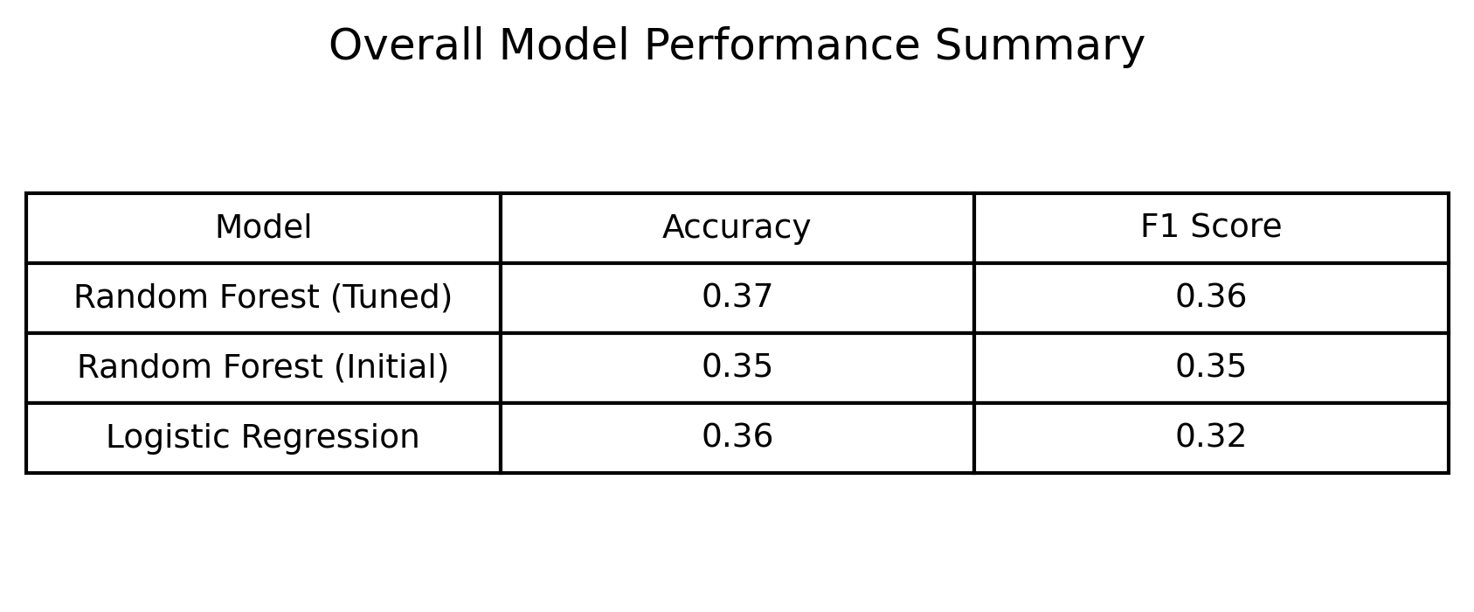
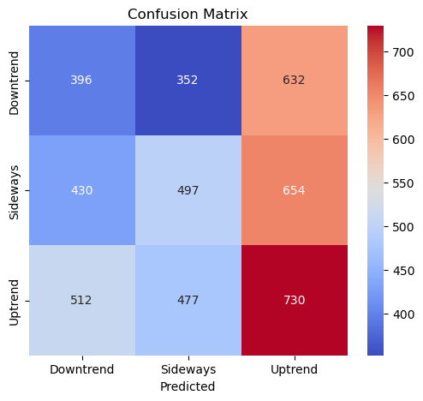
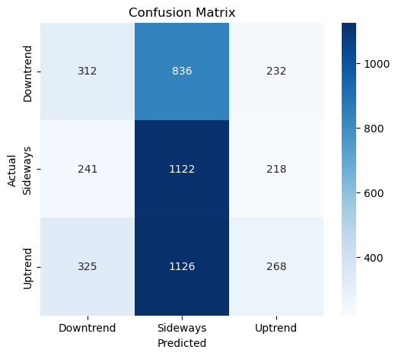
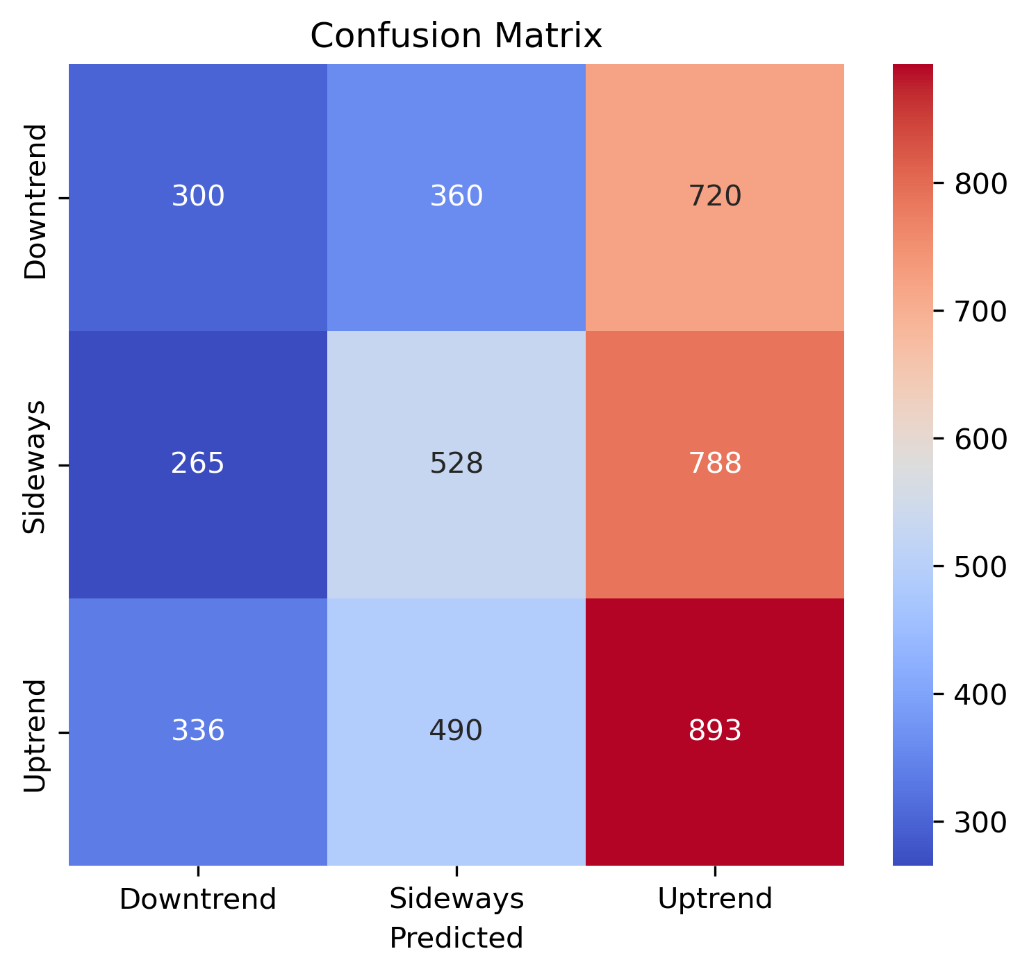
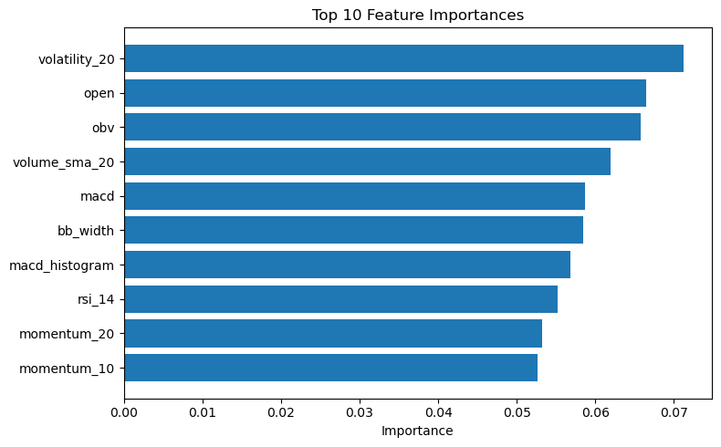
Model Results
A simple comparison table
Random Forest
Baseline
Accuracy
36%
Accuracy:
35%
Tuned Random Forest
Feature Importance (10)
Accuracy
37%

Slide 7
Final Insight
Market is noisy → low accuracy expected
Indicators lag price → turning points missed
Summary:
These results are realistic for financial markets and should be used as decision support rather than a trading engine.
Random Forest performs better
Model supports signals, not trading decisions

Slide 8


No macroeconomic data
No sentiment analysis
Technical indicators only
Short prediction horizon
Limitations
Macroeconomic Data
No Sentiment Analysis
Technical Indicators Only
The model does not account for economic factors such as interest rates, inflation, or policy changes that strongly influence market trends.
Relying solely on price-based indicators restricts the model to historical patterns and ignores fundamental drivers of stock movement.
Investor sentiment from news and social media is excluded, limiting the model’s ability to capture market psychology and sudden reactions.
Predicting trends over a short time window makes it harder to identify,
sustained market direction and increases sensitivity to noise
Short Prediction Horizon:

Slide 9


Recommendations
Add return-based features
Market regime classification
Gradient Boosting / XGBoost
LSTM (Long Short-Term Memory) time-series models

Slide 10
Thank You

